Slide 1

APPLIED MACHINE LEARNING FOR TEXT ANALYSIS,S-7,GROUP-21
AI-Based Fake Profile Detection in Social Networks
An Explainable AI Framework for Detecting Fake, Bot and Impersonation Profiles
Machine Learning
NLP · BERT
Graph Neural Networks
Explainable AI
PROJECT TEAM
D. Sree Aditya
K. Rishikesh Reddy
D. Srivatsava Reddy
2420090056
2420030318
2420030320

Slide 2
01 · THE PROBLEM
Problem Statement
Rapid growth of social platforms has produced a rising number of fake, bot-operated and impersonation accounts.
TRADITIONAL RULE-BASED DETECTION → LIMITED
· Fixed rules and manual thresholds · Limited profile attributes · Single-source information
Spread misinformation
Scams and fraudulent activity
Manipulate likes & followers
Impersonate real users
AI-BASED MULTI-FEATURE DETECTION → ADAPTIVE
Profile + Behaviour + Text + Network signals classified as Genuine / Fake / Bot, with a confidence score and an explanation for every prediction.
Compromise privacy and trust
Evade rule-based detection

Slide 3
02 · GOALS
Objectives
1
Objective 1
2
Objective 2
3
Objective 3
Build AI Detection Framework
Get Feature Extraction
For Predictions- Model Comparison
Automatically detect fake and bot profiles.
Profile metadata, behaviour, text and network relations.
LR, SVM, Random Forest, CNN/LSTM, BERT,GNN
4
Objective 4
5
Objective 5
6
Objective 6
To Display Confidence / Risk Score
To Implement Explainable AI
To Display Data in one Practical Dashboard
A score attached to every profile prediction.
SHAP, LIME and feature importance for reasoning.
Profile analysis, risk level and explanations.

Slide 4
03 · EXISTING WORK
Literature Survey
Study / Approach
Detection Method
Features
Key Finding
Limitation
ML-based fake
account detection(2018)
Random Forest, SVM,
Logistic Regression
Profile metadata,
behavioural attributes
Effective on structured
account features
Strong dependence on
handcrafted features
Deep learning social
bot detection(2022)
CNN / LSTM / DNN
Behavioural and textual
patterns
Learns patterns without
manual feature design
Higher compute cost,
limited interpretability
NLP-based fake
profile detection(2023)
TF-IDF, Word
Embeddings, BERT
Bio and post content
Captures linguistic cues
in profile text
Text-only view ignores
network relationships
Graph-based bot
Detection(2019)
Graph Neural Networks,
graph learning
Follower–following
structure
Uses relational structure
between accounts
Needs graph data;
computationally expensive
Explainable AI for
Classification(2021)
SHAP, LIME, Feature
Importance
Model inputs and
contributions
Explains why a
prediction was made
Usually added on, not
integrated end-to-end
ABBREVIATIONS
CNN — Convolutional Neural Network
BERT — Bidirectional Encoder Representations from Transformers
LSTM — Long Short-Term Memory (network)
SHAP — SHapley Additive exPlanations
DNN — Deep Neural Network
LIME — Local Interpretable Model-agnostic Explanations
TF-IDF — Term Frequency – Inverse Document Frequency

Slide 5
04 · THE GAP
Research Gap Identification
Rule-Based Detection
Cannot adapt easily to evolving fake behaviour
IDENTIFIED RESEARCH GAP
Profile-Based ML
Limited view of user activity
Most existing approaches focus on one or a limited set of information sources, while a unified framework combining profile metadata, behavioural patterns, NLP-based text features, network structure and explainable AI can provide a more comprehensive detection approach.
Behaviour-Based Detection
May ignore textual and network information
Text-Based Detection
Cannot capture social relationships
Graph-Based Detection
Often requires complex network data
Deep Learning
Can be difficult to interpret
Explainable AI
Often not integrated into the full detection pipeline

Slide 6
05 · OUR IDEA
Proposed Solution
HETEROGENEOUS INPUTS
1
Data Preprocessing
2
Feature Engineering
Profile Metadata
Cleaning · normalisation
Metadata · text · graph
Behavioural Data
3
AI / ML Models
4
Fake Profile Classifier
ML · DL · BERT · GNN
Genuine / Fake / Bot
Textual Data
5
Confidence & Risk Score
6
Explainable AI
Network Graph
Probability → risk band
SHAP · LIME
7
Dashboard / Moderator Alert
CORE TECHNOLOGIES
Human-readable explanation
Machine Learning
Deep Learning
NLP
BERT
GNN
Explainable AI

Slide 7
06 · WHAT'S NEW IN APPROACH
Innovation
01
02
03
Multi-Signal Detection
Hybrid AI Approach
Explainable Predictions
Metadata + Behaviour + Text + Network instead of a single feature category.
Benchmark classical ML against deep learning to find the most suitable model.
Identify the influential factors behind each classification, not just a label.
04
Risk-Based Detection
05
Moderator-Oriented Output
Output a risk level and confidence score with an explanation.
Turn model results into insights that support moderation decisions.

Slide 8
07 · DESIGN THINKING
Creativity
01 · PROFILE RISK CARD
02 · EXPLAINABLE AI VIEW
03 · SUSPICION INDICATORS
Username
@example_user
Why was this profile flagged?
• Unusual activity
Risk Level
High
• Suspicious connections
Follower / Following Ratio
Confidence
Model-derived score
• Repetitive content
Account Age
• Abnormal engagement
Suspicious Features
Top contributing signals
• Incomplete profile
Recommended Action
Review / Flag
Posting Frequency
Proposed / planned — not yet implemented
Username Pattern
04 · INTERACTIVE DASHBOARD
Illustrative layout only — bar lengths are not results.
Moderators inspect individual profiles and see the reasoning behind each prediction.

Slide 9
08 · CONTRIBUTION
Novelty of the Proposed Work
Profile Features
+
Behaviour Features
1
Multi-level representation
Combines individual profile, behavioural, textual and network-level information.
NLP / BERT Features
+
Graph / GNN Features
Explainable AI
2
Prediction + Explanation
The framework aims to provide both classification and reasoning together.
↓
UNIFIED DETECTION & EXPLANATION FRAMEWORK
A unified, explainable multi-modal fake-profile detection framework that combines heterogeneous social-network signals and converts AI predictions into human-readable risk insights.
3
Risk-oriented output
Transforms predictions into confidence and risk information useful for moderation.
BERT, GNN, SHAP and Random Forest are established techniques — the novelty lies in their integration into a single application framework.

Slide 10
09 · CAN WE BUILD IT
Feasibility Analysis
Technical
Dataset
Economic
Time
Dataset → Preprocessing → Features → Models → Evaluation → Explainability → Dashboard → Testing
· Python
· Scikit-learn
· TensorFlow / PyTorch
· Transformers
· NetworkX / PyG
· SHAP · LIME
· FastAPI · Streamlit / React
Publicly available candidates on Kaggle:
· Open-source ML libraries
· Public datasets
· Existing student computing resources
· No proprietary software needed for the prototype
· Instagram Fake / Spammer / Genuine Accounts
· Fake Social Media Account Detection
· Twitter Genuine / Fake User Profiles
SCORECARD
Technical
High
Data
High
Dataset sizes to be confirmed after collection.
Economic
High
Time
Moderate–High

Slide 11
10 · ROADMAP
Project Plan — 9 Phases
1
2
3
4
5
6
7
8
9
10
11
12
13
14
15
16
Phase 1 — Problem Definition & Literature Survey
Phase 2 — Dataset Collection & Preprocessing
Phase 3 — Feature Engineering
Phase 4 — Baseline ML: RF · SVM · Logistic Regression
Phase 5 — Deep Learning / NLP / Graph: CNN-LSTM · BERT · GNN
Phase 6 — Evaluation: Accuracy · Precision · Recall · F1 · ROC-AUC
Phase 7 — Explainable AI: SHAP · LIME · Feature Importance
Phase 8 — Dashboard Development
Phase 9 — Testing, Documentation & Final Presentation
Week numbers indicate the planned schedule for the review period.
Department of Computer Science & Engineering

Slide 12
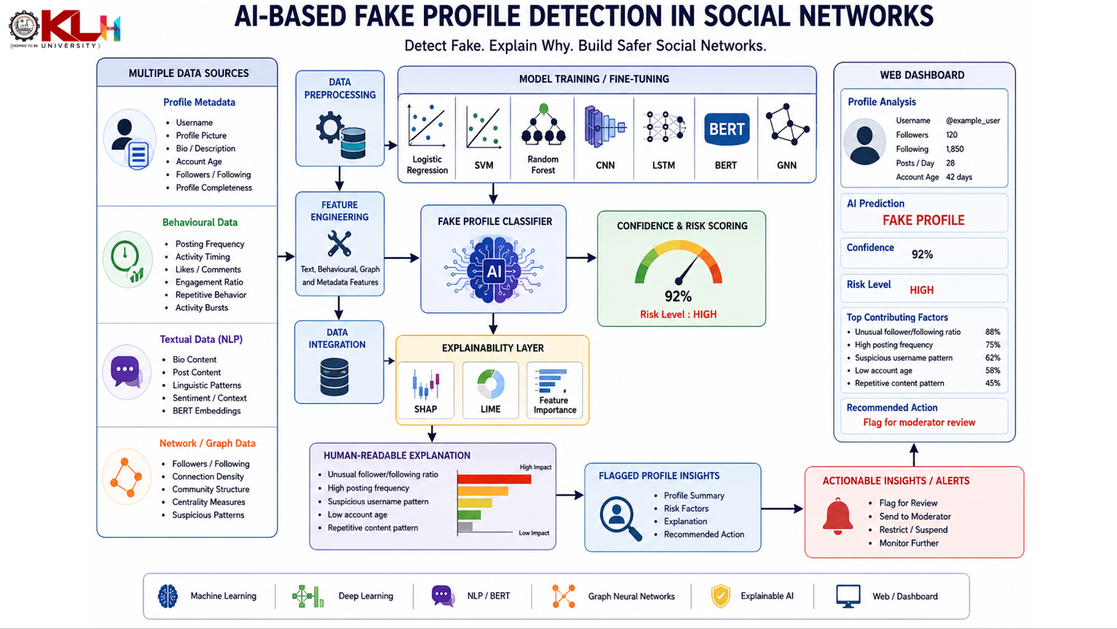

Slide 13
11 · EXPECTED OUTCOME
Outcome & Conclusion
Input Profile
Automated fake-profile classification
Multi-feature analysis
↓
AI Analysis
Confidence / risk scoring
Explainable predictions
↓
Prediction
↓
Comparative evaluation of AI models
Web-based visualization dashboard
Confidence Score
↓
Risk Level
↓
“The proposed system aims to make fake-profile detection more adaptive, comprehensive and interpretable by combining multiple social-network signals with Explainable AI.”
Explanation
↓
Moderator Insight
Thank You
Questions & Discussion

